Slide 1
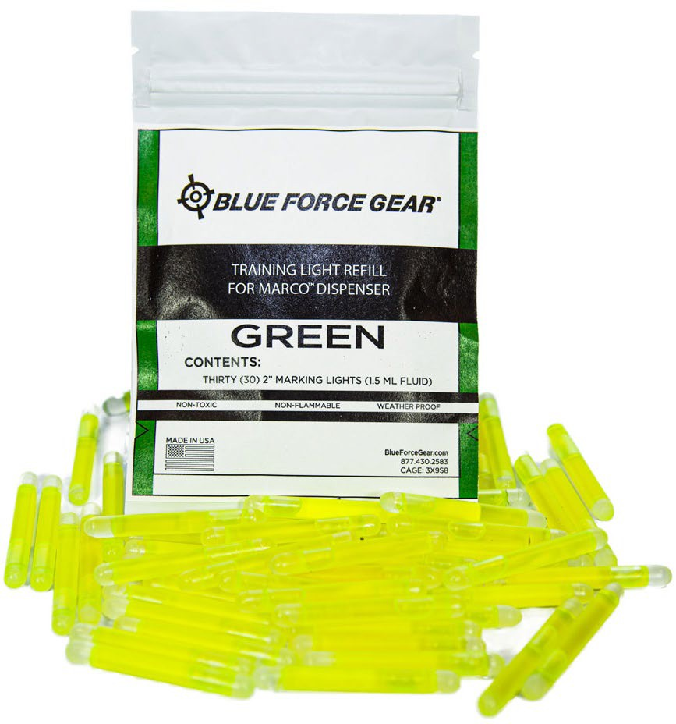
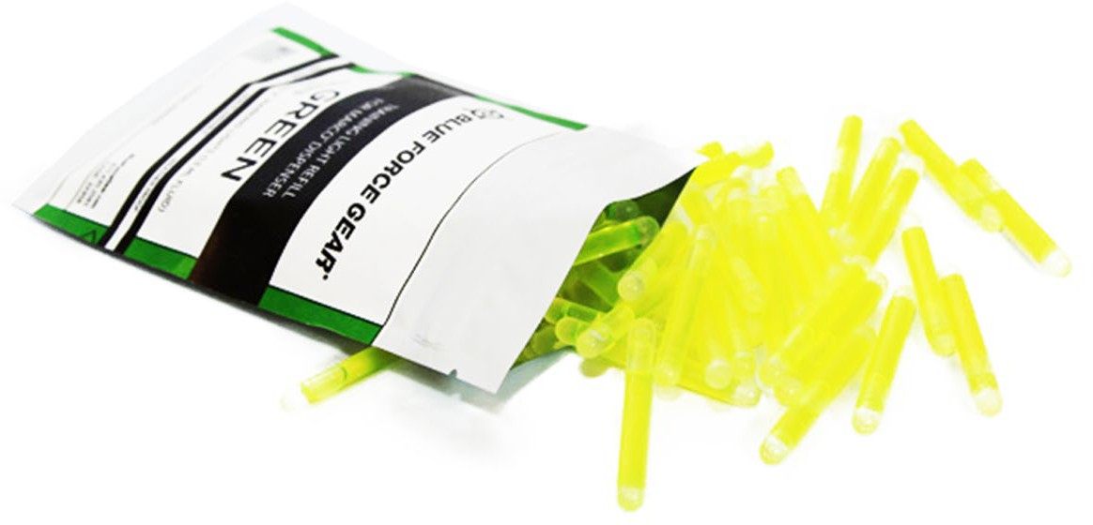


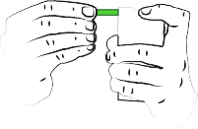
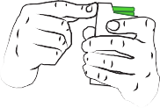




Marco^{Tm} REFILL KIT
The MARCO Training Light Refill Pack tops off your MARCO Marking Light Dispenser and gets it back into action. The refill kit contains 30 individual 2” marking sticks in a resealable bag and allows the user to load one or all of the light sticks in a MARCO Dispenser. Just tear the top off the resealable bag and gently load into the MARCO dispenser. This saves time unwrapping individually packaged sticks and significantly reduces dunnage and packaging waste. The 2” marking sticks provides an equivalent light output of a taped up 4 inch light sticks in a much smaller and lighter package with less bulk than a traditional light stick bundle on your gear.
**We recommend using these Refills for training use only.**
Weight
44g
Part #
MARCO-01-XXXXX-REFILL-1EA
MSRP
$27.95 ($77.95 for Infrared)
Size 30 each MARCO Marking Sticks
Features
Reduce prep time for light sticks to almost Zero
Resealable foil bag reduces marking stick degradation
Keeps marking sticks organized in a predictable, effortless-to-use manner
Materials
HDPE Glass ampule
Binary, non-toxic, chemiluminescence liquid
Colors
Green, Blue, Red & Infrared
PUSHING DOWN ON THE ALREADY LOADED MARKING LIGHTS AND INSERT THE NEXT LIGHT TO BE LOADED THROUGH THE SIDE APERTURE
FULLY INSERT THE MARKING LIGHT
REPEAT WITH REMAINING MARKING LIGHTS
NOTE THAT MARCO ™ IS ONLY MEANT TO HOLD 30 MARKING LIGHTS
MADE IN USA
COLORS:
CAGE:3X9S8 166 Pine Barren Rd Pooler, GA 31322 877.430.2583
Limited Lifetime Warranty
facebook.com/blueforcegearinc
100% Berry Compliant
Specifications are approximate and subject to change without notice
©2019 Blue Force Gear, Inc. All Rights Reserved.

